Slide 1
Overcoming the zero bound on interest rate policy
Written By: Marvin Goodfriend
Presented By: Yuanfang Liu

Slide 2
Marvin Goodfriend
Director of research and policy advisor at the Federal Reserve Bank of Richmond from 1993 to 2005.
This paper was published in 2000.

Slide 3
What is zero bound problem
Fisher pointed that if a commodity could be stored costlessly over time, then the rate of interest in units of that commodity could never fall below zero.
No one will lend money at negative nominal interest if cash is costless to carry over time.

Slide 4
Why it is an issue
Real interest rates must fluctuate to stabilize the economy over the business cycle. Negative real interest rates may have helped the economy to recover from recession in the past, particularly in the periods of financial market stress.
Deflation expectations in economic downturns can actually raise expected real interest rates when nominal rates are at the zero bound, with perverse effects on demand and employment.
Nominal interest rate = Real interest rate + inflation rate

Slide 5
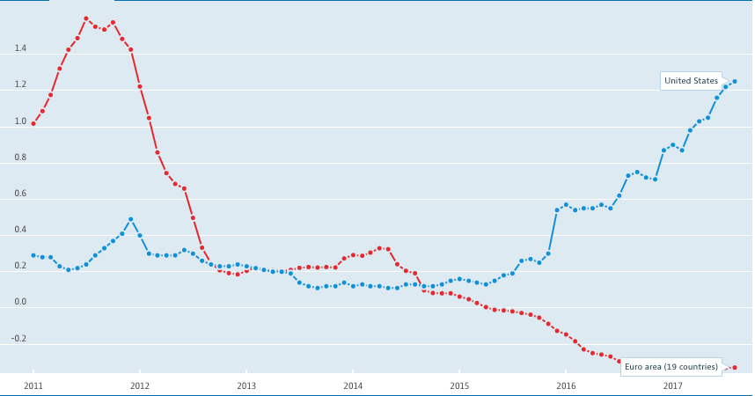
Current Short-term interest rate
* Graph from https://data.oecd.org/interest

Slide 6
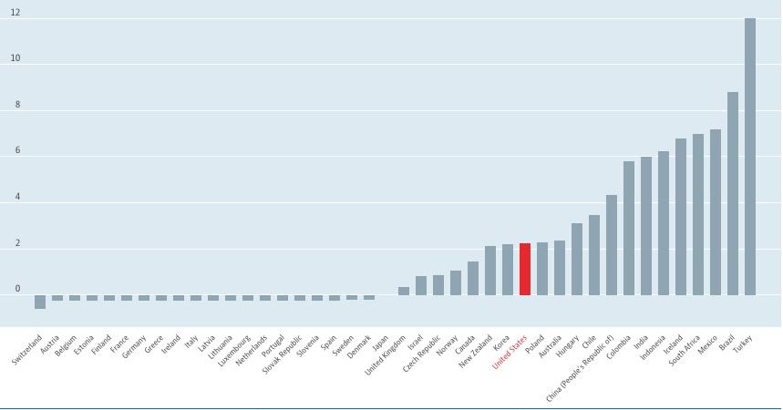
2018 Short-term interest rate forecast
* Graph from https://data.oecd.org/interest

Slide 7
Three options to overcome zero bound
A carry tax on money
Open market operation in long bonds
Monetary transfers

Slide 8
A Carry Tax on Money

Slide 9
Imposing the Carry Tax
Impose a carry tax on electronic bank reserves
Good: competition among banks to avoid the carry tax would push the interbank below zero. The interbank rate would go no lower because banks would not lend reserves at a loss greater than the storage cost of electronic reserves.
Bad: if carry tax is high, banks and the public would probably hoard currency rather than lend it.
Impose a carry tax on vault cash and currency

Slide 10
Technological Feasibility
Modern payments system technology makes it possible to impose and vary a carry tax on electronic bank reserves at the central bank. Whenever the intended target for the interbank interest rate reached zero, the policy committee could activate a daily tax on electronic reserve balances.
A carry tax could be imposed on currency by imbedding a magnetic strip in each bill. The magnetic strip could visibly record when a bill was last withdrawn from the banking system. A carry tax could be deducted from each bill upon deposit according to how long the bill was in circulation.

Slide 11
Carry Tax vs. Inflation Tax
What is inflation tax?
Inflation tax is not an actual tax paid to the government. It is a penalty for holding cash during high inflation.
Nominal interest rate = Real interest rate + Inflation rate

Slide 12
Carry Tax vs. Inflation Tax
Carry Tax | Inflation Tax
Imposed temporarily | Permanent distortionary
No effect on the opportunity cost of holding money | Effect on the opportunity cost of holding money
Permanent administrative cost involved in operating and maintaining system | Relative low cost

Slide 13
Open Market Operation in Long Bonds

Slide 14
Notions of Liquidity Services
Narrow liquidity services: provided by the medium of exchange allowing the public to economize on ”shopping time” in transactions.
Broad liquidity services: a service yield provided by assets according to how easily they can be turned into cash, either by sale or be serving as collateral for external financing.
External finance premium: imperfect information and costly enforcement of contacts created a wedge between the cost of fund raise externally and internal funds.

Slide 15
Banks and Open Market Purchases
Banks during economy depression:
Difficult to attract new borrowers without an accompanying decline in interest rates
External finance premium increases and acceptable borrowers harder to find
Open market purchase:
Put cash in the hands of the nonbank public

Slide 16
Why long bond?
Relative little liquidity services
Higher risk of capital loss
More haircut off market value when used as collateral
Increase cost of sale
Open market purchases that monetize longer-term bonds when interest rates are low could increase substantially broadly defined monetary liquidity.

Slide 17
An Adverse Aggregate Demand Shock - example
Expected decline in future income
Households cut current consumption
Firms cut current investment
Decline in firm demand for labor

Slide 18
Depressed Economy in Asset Markets - example
Consumption spending on durables (cars and houses)
Price of durables
Firm profits and marginal product of capital
Price of physical capital and claims to intellectual and organizational capital
Also, the collapse in asset values reduces net worth, the capital of banks, and the value of collateral available for loans. This raises the external finance premium and depresses current spending further.
On net, the contraction increases the demand for liquidity services broadly defined.

Slide 19
Monetary Transmission at the Interest Rate Floor – Portfolio Rebalancing Channel
Open market purchases reduce the high implicit marginal liquidity services yield on monetary assets
Holders of monetary assets seek to rebalance their portfolio by acquiring less liquid assets
Higher asset price
……

Slide 20
Monetary Transmission at the Interest Rate Floor – Credit Channel
Open market purchases reduce external finance premium
Collateral value reflate, net worth increase
Credit spreads narrow
Spending increases because the cost of borrowing falls
……

Slide 21
Monetary Transfers

Slide 22
Monetary Transfers
Monetary transfer: to inject money directly to the public
For example, monetary transfer can be achieve by cutting taxes.
A central bank would transfer money to the public by buying long bonds at low or negative nominal interest and subsequently selling them back to the public with unexpected capital losses.

Slide 23
Two Possible Results
Result 1: the economic recovery raises income and real wealth enough to absorb the monetary transfers as permanent additions to the public’s desired stock of monetary asset.
Result 2: the public’s demand for money does not rise to absorb the monetary transfers after the economy recovers. In this case, central bank would reverse any monetary transfers expected to create inflation.

Slide 24
Monetary Transfer Reverse
Method 1: the government could temporarily increase taxes relative to spending
Method 2: the central bank could sell securities, in which case the public would receive a stream of interest payments matched by an offsetting stream of higher taxes.

Slide 25
Quantitative Policy Challenges
Quantitative policy would lack credibility if a central bank were unable to take capital losses
Quantitative policy results in a permanent increase of government debt in the hands of the public
Quantitative policy would lack credibility if the country were unwilling to accept a increased government debt

Slide 26
How to Solve the Issue?
Treasury could agree to indemnify the central bank against capital losses
Treasury supports monetary policy with fiscal policy (for example, increasing government debt in the hands of the public)

Slide 27
My Thoughts

Slide 28
Thoughts
Relative applicable as of 2000
The ideas of carry tax and monetary transfer are relative creative
Rich information

Slide 29
Thoughts
This paper is aged
Negative interest rate is not the best choice
It is really had to decide what is the most appropriate way to impose tax or do quantitative easing
Relationship between Treasury and Central Bank!

Slide 30
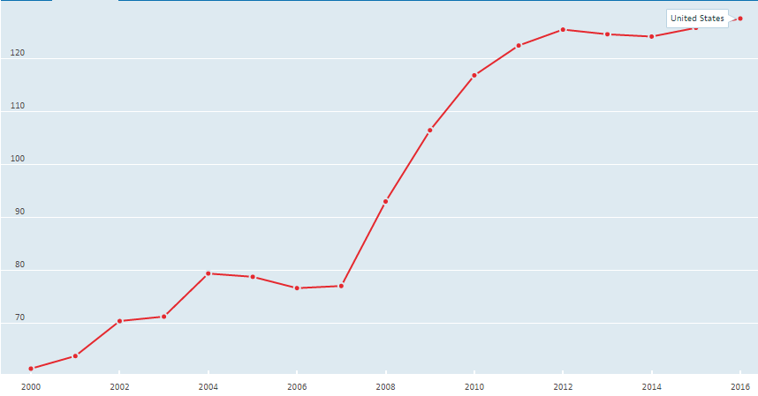
US Government Debt as % of GDP

Slide 31
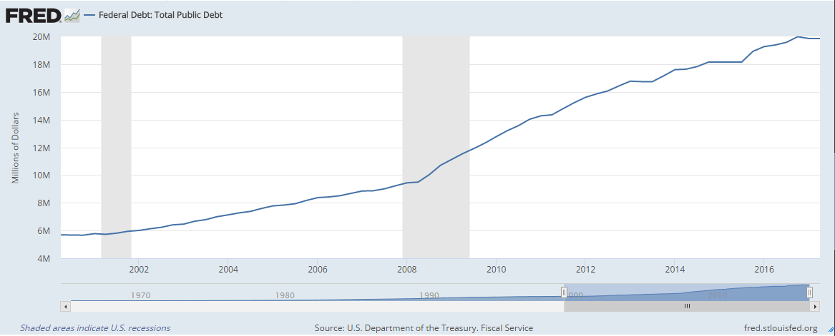
US Government Debt in Public

Slide 32
Reference
Overcoming the Zero Bound on Interest Rate Policy
Source: Journal of Money, Credit and Banking, Vol. 32, No. 4, Part 2: Monetary Policy in a Low-Inflation Environment (Nov., 2000), pp. 1007-1035
Published by: Ohio State University Press
Stable URL: http://www.jstor.org/stable/2601157

Slide 33
Thank you

